Slide 1


What’s new in ASP.NET 3.5 SP1
Simone Chiaretta Solution Developer, Avanade
http://codeclimber.net.nz
24 Ottobre 2008

Slide 2



Sponsors

Slide 3
Agenda
Dynamic Data
Routing
Migliorie JavaScript
What else?

Slide 4
Dynamic Data aka Scaffolding

Slide 5
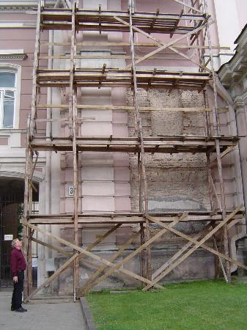
Dynamic Data
Ruby-like scaffolding

Slide 6
Dynamic Data
Linq-to-SQL
Linq-to-Entities
Completamente modificabile
Controlli di editing in base al tipo

Slide 7
Dynamic Data: how to
LINQ-to-Sql designer
“Scommenta” riga di codice
F5 (RUN)
Enjoy ☺

Slide 8
[DEMO]
Dynamic Data

Slide 9
ASP.NET Routing

Slide 10

Routing
Where do you want to go today?

Slide 11
Benefici
SEO Friendly
RESTful
Hackable

Slide 12
Routing Concepts
Routes
RouteHandler

Slide 13
Route
Contenitore di proprietà
Url
Constraints
Defaults
DataTokens
...
Route myRoute = new Route(
"archive/{year}/{month}/{day}", //Url
new EventsRouteHandler() //RouteHandler
);
myRoute.Constraints = new RouteValueDictionary(
new
{
year = @"\d{2}|\d{4}",
month = @"\d{1,2}",
day = new DateIsValidConstraint()
});

Slide 14
Segments -> Url Parameters
archive/{year}/{month}/{day}
http://blog.com/archive/2008/10/06
year = 2008
month = 10
day = 6

Slide 15
[DEMO]
RouteDebugger

Slide 16
RouteHandler
Gestisce la richiesta
MvcRouteHandler
DynamicDataRouteHandler
Custom
IRouteHandler
GetHttpHandler

Slide 17
Routing con WebForm
public class EventsRouteHandler : IRouteHandler
{
public IHttpHandler GetHttpHandler(RequestContext requestContext)
{
IHttpHandler result = BuildManager
.CreateInstanceFromVirtualPath("~/Events.aspx",
typeof(Events)) as IHttpHandler;
return result;
}
}

Slide 18
[DEMO]
Routing su WebForm

Slide 19
Javascript as first class language

Slide 20

Supporto in Visual Studio
Code Formatting
Intellisense per librerie esterne JS
“Ottimizzato” per jQuery

Slide 21
jQuery
Facilita la selezione di elementi
//Classic way
document.getElementById("elementId")
//jQuery way
$("#ElementId")
Selettori CSS3
$("#container .article ul")
$("div span:first-child")

Slide 22
jQuery - Eventi
Astrae l’accesso agli eventHandler (crossbrowser)
$(document).ready(function(){
alert("I'm loaded, but the images not yet");
});
$(“element”).click(function(){
alert(“Clicked”);
});

Slide 23
jQuery – Fluent Interface
Chaining
$(“#elementId").addClass(“wowClass”).fadeIn(“slow”);
Callbacks
$(“#elementId").slideDown(“slow”, function() { $(this).addClass("wow")
});

Slide 24
What else?

Slide 25
Ma c’è di più
ASP.NET Ajax Script Combiner
Miglior gestione Back/Forward in AJAX
Intellisense per ASP Classic 😐
WPF v3
Direct 3D interop
Entity Framework (ask Saltarello’s opinion ☺)

Slide 26
Maggiori informazioni
Annuncio di ScottGu: http://tinyurl.com/aspnet35sp1
Dynamic Data http://www.asp.net/dynamicdata/
jQuery: http://jquery.com/
jQuery Intellisense: http://blogs.ipona.com/james/

Slide 27

Contatti – Simone Chiaretta
MSN: simone_ch@hotmail.com
Blog:
English: http://codeclimber.net.nz/
Italiano: http://blogs.ugidotnet.org/piyo/
Twitter: http://twitter.com/simonech

Slide 28

Q&A

